Slide 1
Ischemic Stroke
Jennifer Beckman RN, BSN
March 23, 2012
MSN 621

Slide 2
Ischemic Stroke Case Study
T.H. is a 70 y/o female and enjoying lunch with with her daughter. During lunch her daughter notices T.H. is unable to grasp the fork properly in her right hand. She has developed a right facial droop. Her daughter asked if she was feeling okay and T.H. could not remember who her daughter was. 911 was initiated and arrived within 10 minutes.

Slide 3
Ischemic Stroke Outcomes
- Define Ischemic Stroke
- Understand Pathophysiology
- Explain signs and symptoms
- Outline treatment options

Slide 4
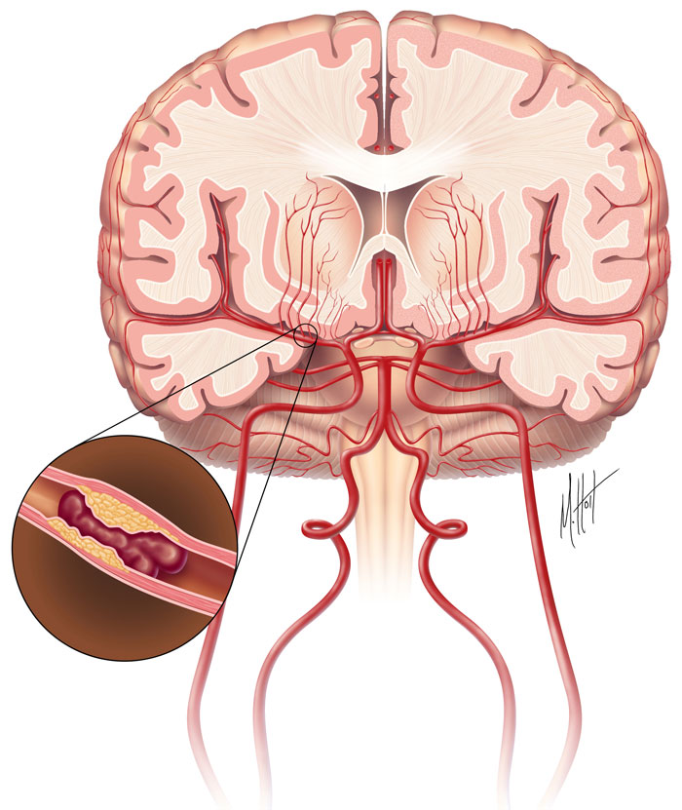
What is Ischemic Stroke?
- Blocked artery in the brain
- When an artery is blocked, brain cells cannot make enough energy and will stop working
- Brain depends on arteries to bring fresh blood from heart
and lungs
- If an artery remains blocked for more than a few minutes, brain cells may die
- Blood carries oxygen and nutrients to the brain, and takes away carbon dioxide and cellular waste
- Immediate medical treatment is vital
The Internet Stroke Center. (n.d.). Retrieved February 7, 2012, from Ischemic Stroke: http://www.strokecenter.org/patients/about-stroke/ischemic-stroke/ Used with permission.

Slide 5
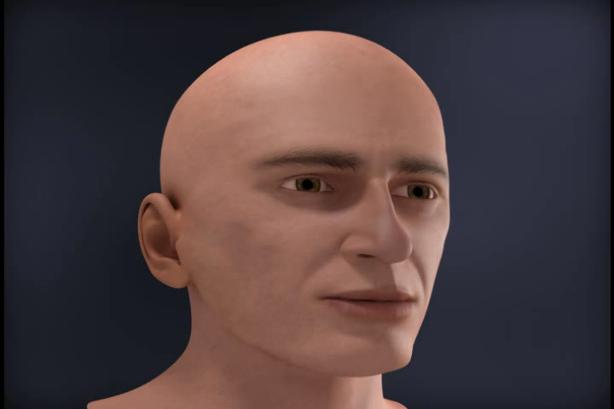
Ischemic Stroke Animation
National Stroke Association. (2012). Retrieved February 7, 2012, from Types of Stroke: http://www.stroke.org/site/PageServer?pagename=TYPE Used with permission.

Slide 6
General Brain Function
- What two products below does blood carry away from the brain?
Cellular Waste
Yes, great job!
Carbon Dioxide
Correct!
Oxygen
Try Again

Slide 7
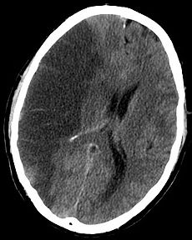
Pathophysiology of Ischemic Stroke
- Extent of damage depends on severity of
ischemia
- Inflammatory mediators IL-1B and TNF- α contribute to edema and microvascular thrombosis
- CT scan slice of the brain showing a
right-hemispheric stroke
- Neurons die when perfusion is < 5% of normal for > 5 min
- Edema may increase intracranial pressure if severe
  - Increased pressure will deprive brain cells of oxygen
  - May damage brain cells if edema persists
Wikipedia. (2012, March 29). Stroke. Retrieved March 30, 2012, from Wikipedia: http://en.wikipedia.org/wiki/Ischemic_stroke#Ischemic Image used with permission
from Wikimedia Commons.
Elias A. Giraldo, M. (2007, April). Ischemic Stroke. Retrieved February 7, 2012, from The Merk Manual: http://www.merckmanuals.com/professional/neurologic_disorders/stroke_cva/ischemic_stroke.html

Slide 8
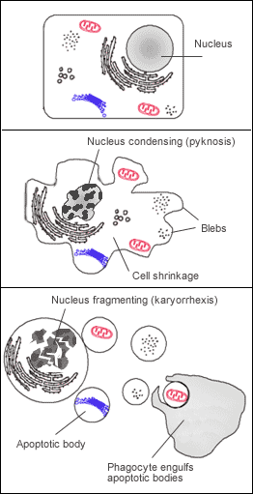
Pathophysiology of Ischemic Stroke
Apoptosis Diagram
- Promptly restoring blood flow may reduce or reverse injury
- Mechanisms of ischemic injury include: edema, microvascular thrombosis, apoptosis (programmed cell death), infarction with cell necrosis
- Damage occurs more rapidly during hyperthermia
and more slowly during hypothermia
Wikipedia. (2012, March 29). Stroke. Retrieved March 30, 2012, from Wikipedia: http://en.wikipedia.org/wiki/File:Apoptosis.png Image used with permission from Wikimedia Commons
Elias A. Giraldo, M. (2007, April). Ischemic Stroke. Retrieved February 7, 2012, from The Merk Manual: http://www.merckmanuals.com/professional/neurologic_disorders/stroke_cva/ischemic_stroke.html

Slide 9
Ischemic injury cascade
Lack of O2 causes neuron's process for making ATP for energy fail
↓
Cells switch to anaerobic metabolism, producing lactic acid
↓
ATP-reliant ion transport pumps fail, causing cell to become depolarized, allowing ions, including Ca⁺⁺, to flow into the cell
↓
The ion pumps can’t transport Ca⁺⁺ out of the cell, intracellular calcium levels get too high
↓
Ca⁺⁺ triggers release of glutamate, an excitatory amino acid neurotransmitter
↓
Glutamate stimulates AMPA receptors and Ca⁺⁺-permeable NMDA receptors, which open to allow more Ca⁺⁺ into cells.
↓
Excess Ca⁺⁺ entry overexcites cells and causes the generation of harmful chemicals
↓
Cell's membrane is broken down by phospholipases, becomes more permeable, and more ions and harmful chemicals flow into the cell
↓
Mitochondria break down, releasing toxins and apoptotic factors into the cell
↓
As cells die through necrosis, it releases glutamate and toxic chemicals into environment. Toxins poison nearby neurons, and glutamate can overexcite them.
Wikipedia. (2012, February 1). Ischemic cascade. Retrieved April 13, 2012, from Wikipedia: http://en.wikipedia.org/wiki/Ischemic_cascade

Slide 10
Pathophysiology of Ischemic Stroke
- What is a mechanism that can cause ischemic injury?
Hypertension
No, this is not a direct mechanism
Edema
Yes!

Slide 11
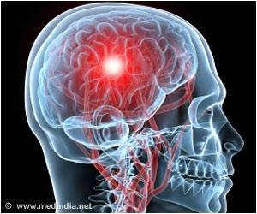
Signs and Symptoms of Ischemic Stroke
- Sudden numbness of the face, arm, or leg, especially on one side of the body
- Sudden confusion, trouble speaking or understanding speech
- Sudden trouble seeing in one or both eyes
- Sudden trouble walking, dizziness, loss of balance or coordination
- Sudden severe headache with no known cause
Jones, K. (2012, February 4). Med India Network for Health. Retrieved February 15, 2012, from Risk of Ischemic Stroke may be Aggravated by Infections in Childhood: http://www.medindia.net/news/risk-of-ischemic-stroke-may-be-aggravated-by-infections-in-childhood-97035-1.htm Used with permission.
The Internet Stroke Center. (n.d.). Retrieved February 7, 2012, from Ischemic Stroke: http://www.strokecenter.org/patients/about-stroke/ischemic-stroke/

Slide 12
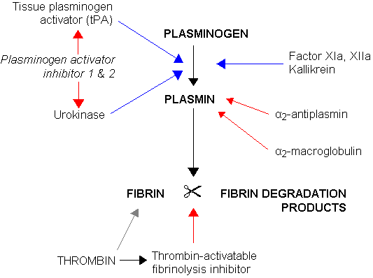
Treatment Options for Ischemic Stroke
- Thrombolytic (Fibrinolytic) Drugs
  - Tissue Plasminogen Activator (tPA) is given intravenously to break up clots and help restore blood flow to the brain
- Antiplatelet Drugs and Anticoagulants
  - ASA, Heparin, Warfarin
- The figure to the right demonstrates clot fibrinolysis. Blue arrows denoting stimulation, and red arrows inhibition.
File: Fibrinoysis.png. (2005, April 26). Retrieved February 19, 2012, from Wikipedia The Free Encyclopedia: http://en.wikipedia.org/wiki/File:Fibrinolysis.png Used with permission.
Elias A. Giraldo, M. (2007, April). Ischemic Stroke. Retrieved February 7, 2012, from The Merk Manual: http://www.merckmanuals.com/professional/neurologic_disorders/stroke_cva/ischemic_stroke.html

Slide 13
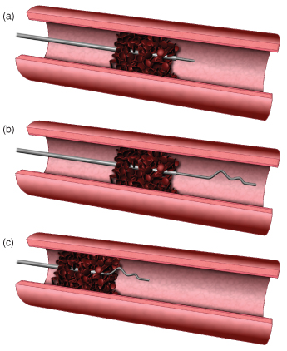
Treatment Options for Ischemic Stroke
- Surgery
  - Carotid Endarterectomy
- Stents
  - Completed if Endarterectomy is too risky
- Other Treatments
  - Tiny corkscrew-shaped device or vacuum used to snag clot and remove it
National Stroke Association. (2012). Retrieved February 7, 2012, from Types of Stroke: (Shaping the Future of Aneurysm Treatments, 2008) Used with permission.
Elias A. Giraldo, M. (2007, April). Ischemic Stroke. Retrieved February 7, 2012, from The Merk Manual: http://www.merckmanuals.com/professional/neurologic_disorders/stroke_cva/ischemic_stroke.html

Slide 14
Treatment Options for Ischemic Stroke
- What of the following are examples of invasive treatment options for Ischemic Stroke.
tPA
Try again, is this an invasive option?
Heparin
Good guess!
Stents
Correct!

Slide 15
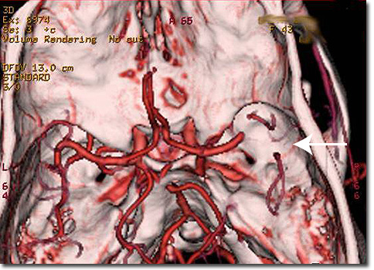
Summary of Ischemic Stroke
Angiogram 3D Reconstruction Showing Area of Intracranial Arterial Blockage
- Define Ischemic Stroke:
  - A blocked artery in the brain
  - Brain is unable to receive oxygen
- Understand Pathophysiology:
  - Mechanism of injury: edema, microvascular thrombosis, apoptosis, infarction with cell necrosis
  - Neurons die without oxygen
- Outline treatment options:
  - Medications, surgery, stents
- Explain signs and symptoms:
  - Numbness, headache, confusion, trouble seeing and walking
Treating Acute Ischemic Stroke. (n.d.). Retrieved February 19, 2012, from The University Hospital: http://www.theuniversityhospital.com/stroke/ischemic.htm Used with permission from Charles Prestigiacomo, MD, Chair, Department of Neurosurgery, UMDNJ-University Hospital

Slide 16
Literature Cited
- Elias A. Giraldo, M. (2007, April). Ischemic Stroke. Retrieved February 7, 2012, from The Merk Manual: http://www.merckmanuals.com/professional/neurologic_disorders/stroke_cva/ischemic_stroke.html
- File: Fibrinoysis.png. (2005, April 26). Retrieved February 19, 2012, from Wikipedia The Free Encyclopedia: http://en.wikipedia.org/wiki/File:Fibrinolysis.png
- Jones, K. (2012, February 4). Med India Network for Health. Retrieved February 15, 2012, from Risk of Ischemic Stroke may be Aggravated by Infections in Childhood: http://www.medindia.net/news/risk-of-ischemic-stroke-may-be-aggravated-by-infections-in-childhood-97035-1.htm
- National Stroke Association. (2012). Retrieved February 7, 2012, from Types of Stroke: Shaping the Future of Aneurysm Treatments, 2008
- The Internet Stroke Center. (n.d.). Retrieved February 7, 2012, from Ischemic Stroke: http://www.strokecenter.org/patients/about-stroke/ischemic-stroke/
- Treating Acute Ischemic Stroke. (n.d.). Retrieved February 19, 2012, from The University Hospital: http://www.theuniversityhospital.com/stroke/ischemic.htm
- National Stroke Association. (2012). Retrieved February 7, 2012, from Types of Stroke: http://www.stroke.org/site/PageServer?pagename=TYPE
- Wikipedia. (2012, February 1). Ischemic cascade. Retrieved April 13, 2012, from Wikipedia: http://en.wikipedia.org/wiki/Ischemic_cascade
- Wikipedia. (2012, March 29). Stroke. Retrieved March 30, 2012, from Wikipedia: http://en.wikipedia.org/wiki/Ischemic_stroke#Ischemic
- Wikipedia. (2012, March 29). Stroke. Retrieved March 30, 2012, from Wikipedia: http://en.wikipedia.org/wiki/File:Apoptosis.png Image used from Wikimedia Commons

